Slide 1
Flare towers
Nidhi Kulkarni

Slide 2
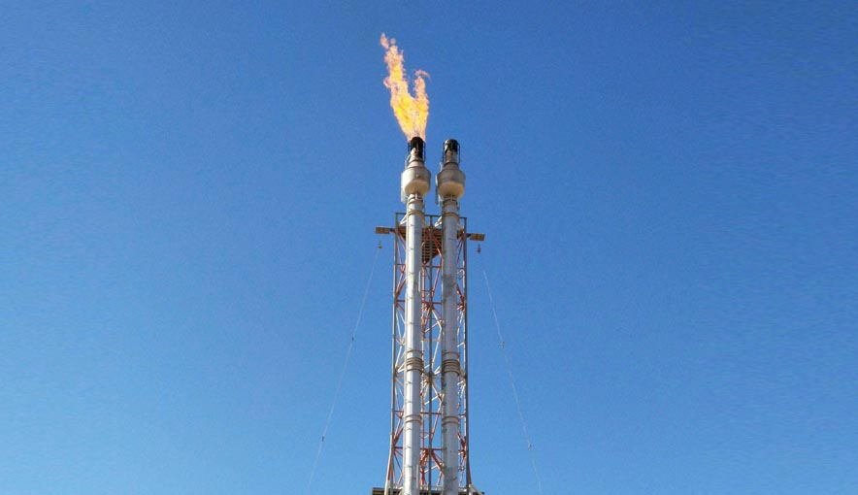

Slide 3
01
03
Header
Liquid seal
02
04
Flash Knockout drum
Flare stack

Slide 4
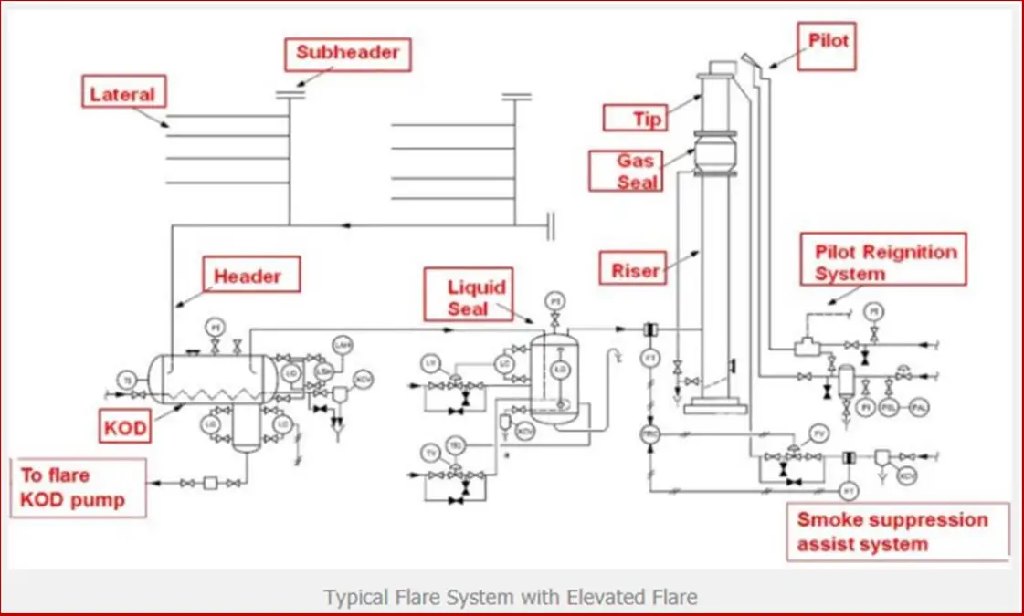

Slide 5
FLARE DRUM SIZING
- API rp 521
- stokes droplet size of 500-600 mm
- 20-30 minutes of holdup time
- no internals to facilitate separation and eliminate potential blockages
- many orientations and options(horizontal and vertical)
- liq removed by flare pumps

Slide 6

Environmental concerns
Complete combustion
CO2 release
Height of flare tower

